Slide 1

Platform management for mobile reception robot
https://usom.gfai-robotics.com/
Account:jmfl0886
Password: 7pbx1cHW3

Slide 2
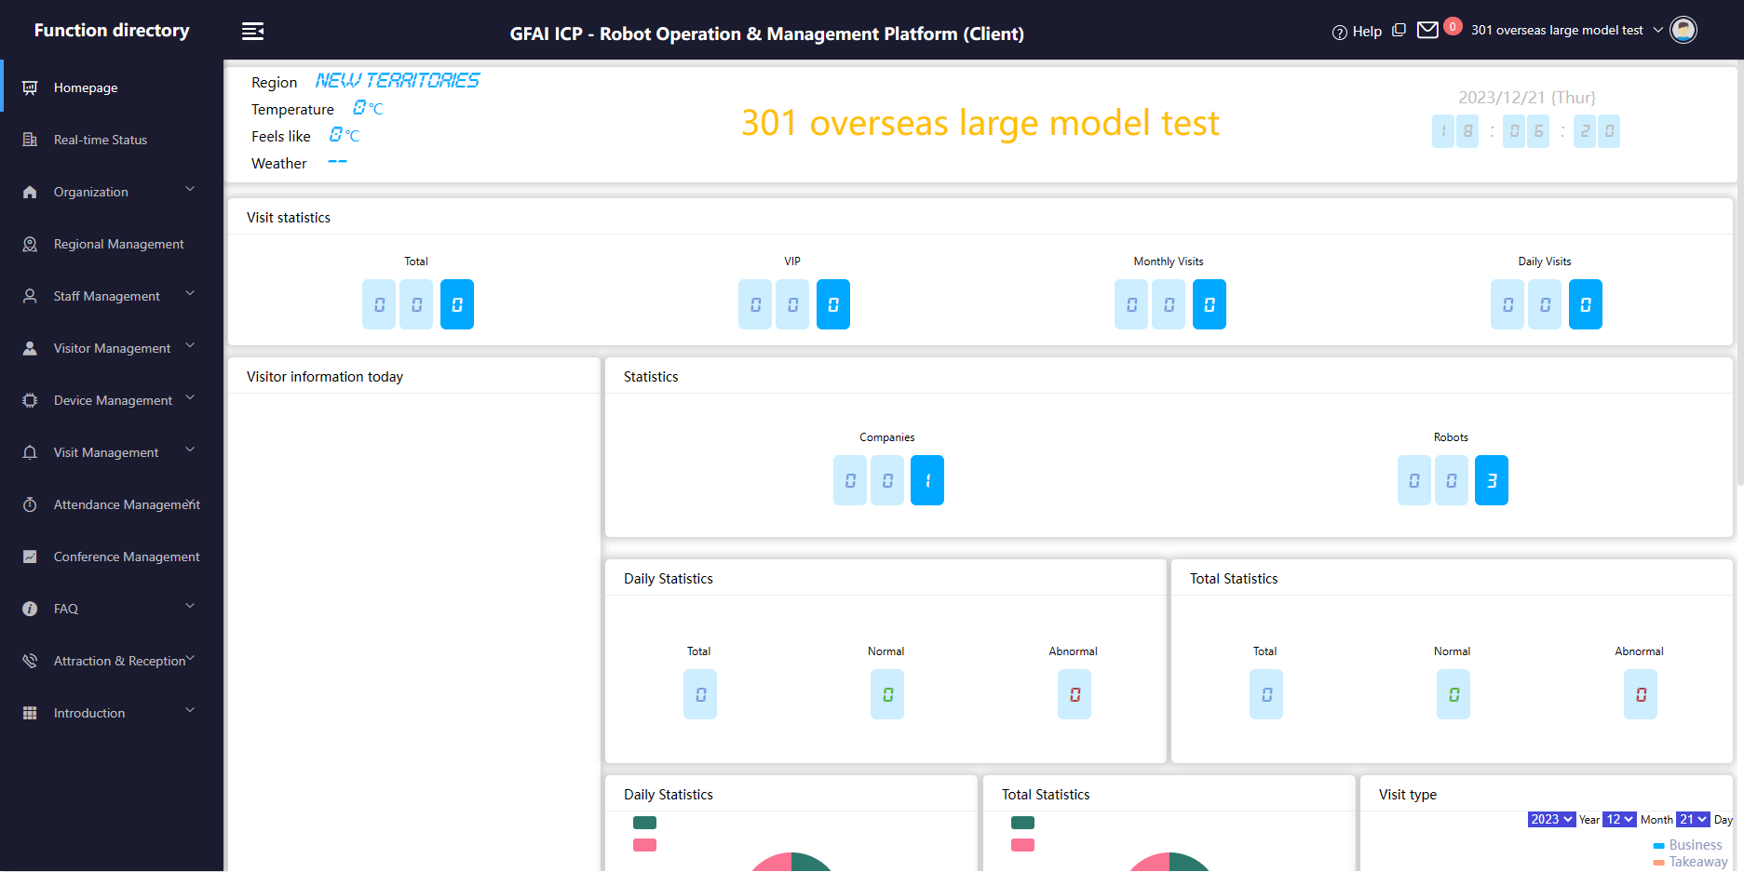
After successful login, the left side is the device menu bar, where all settings are made.

Slide 3
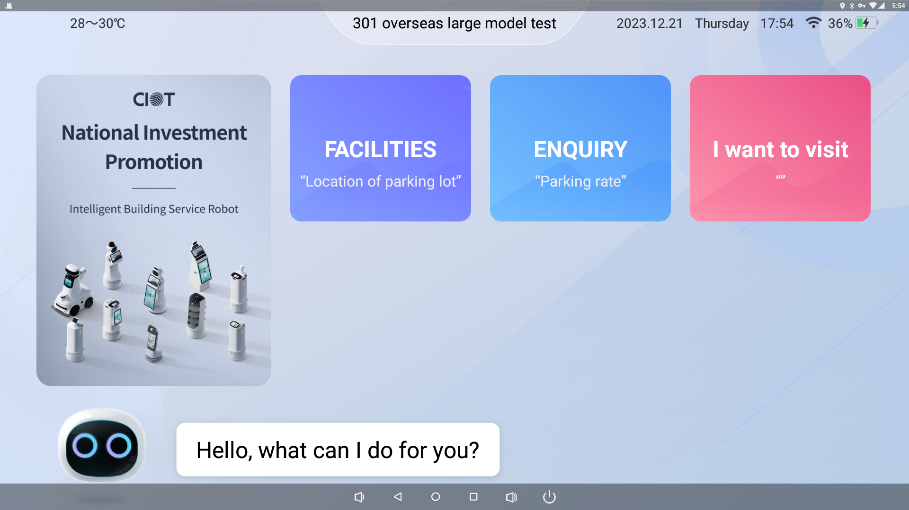
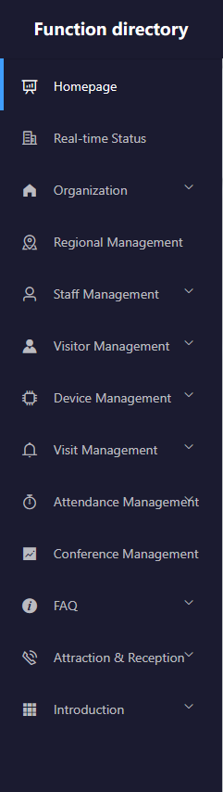
FACILITIES
(基础设施)
This picture shows the robot home page interface(此图为机器人主页界面).
There are three main functional modules(有三个主要功能模块):
GUIDED（迎宾导览）
ENQUIRY（咨询服务）
FACILITIES（基础设施）
ENQUIRY
(咨询服务)
GUIDED
(迎宾导览)

Slide 4
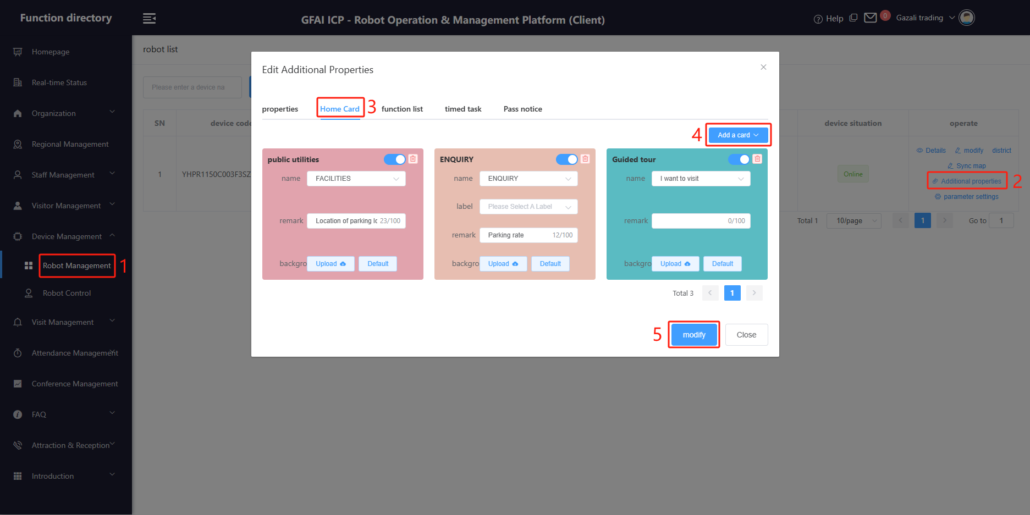
1.Feature card display settings（功能卡片显示设置）:
Operation path: As shown in the picture: 1 ==> 2 ==> 3 ==> 4 ==> 5
(操作路径如图所示:1 ==> 2 ==> 3 ==> 4 ==> 5）
Tip: The mobile reception robot supports three function cards, please do not set other function cards.
(提示:移动接待机器人支持三张功能卡，请不要设置其他功能卡）

Slide 5
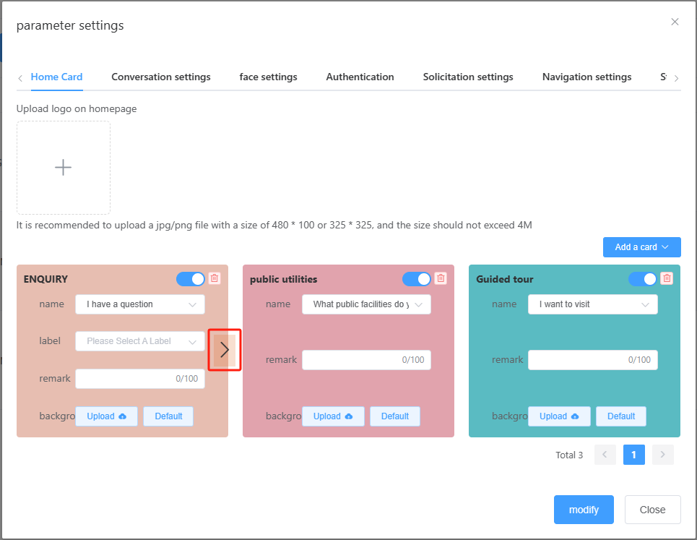
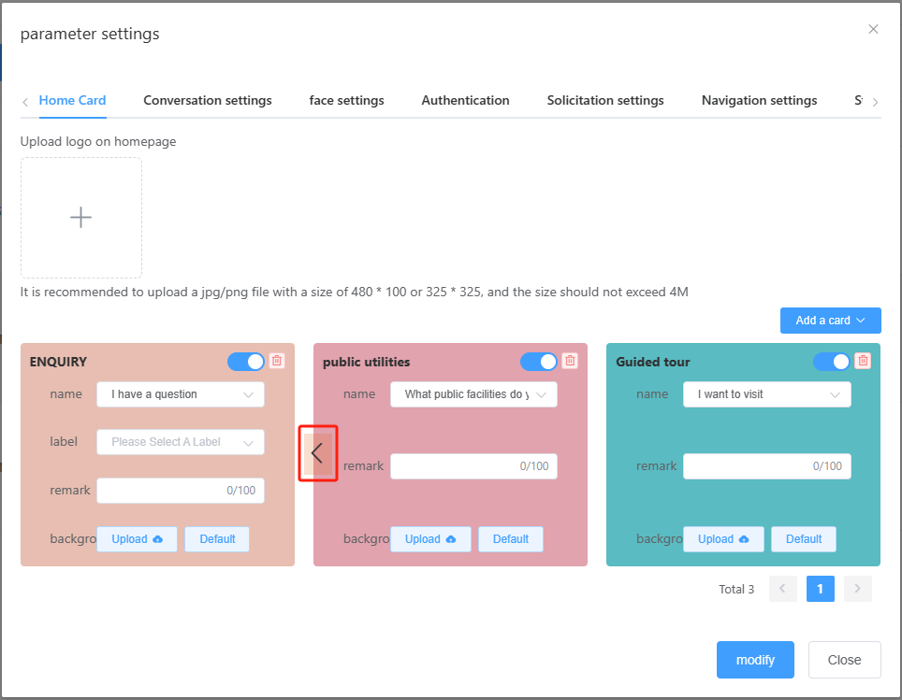
1.Feature card display settings（功能卡片显示设置）:
Place the mouse over the arrow position to adjust the card position(将鼠标悬停在箭头位置上点击调整卡片位置).
After the adjustment, the position of the card on the main interface of the robot will also change.
(调整后，卡片在机器人主界面上的位置也会发生变化)
Turn off or on Function Modules (关闭或打开功能模块).

Slide 6
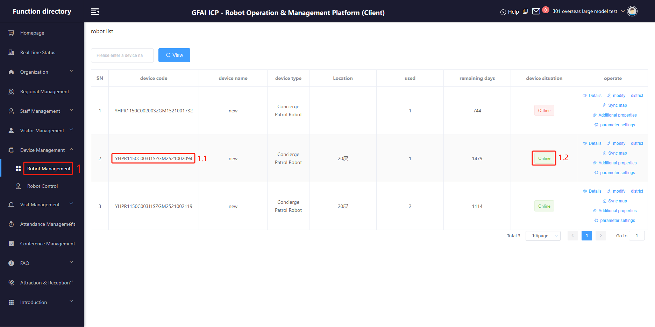
2. Basic function settings of the robot body(机器人本体基本功能设置)
1.1 When there are multiple robots, please confirm the device number of the target robot before setting it up.
(当有多台机器人时，在设置之前请确认目标机器人的设备编号)
1.2 Please confirm whether the robot is online before setting(设置之前请确认机器人是否在线).

Slide 7
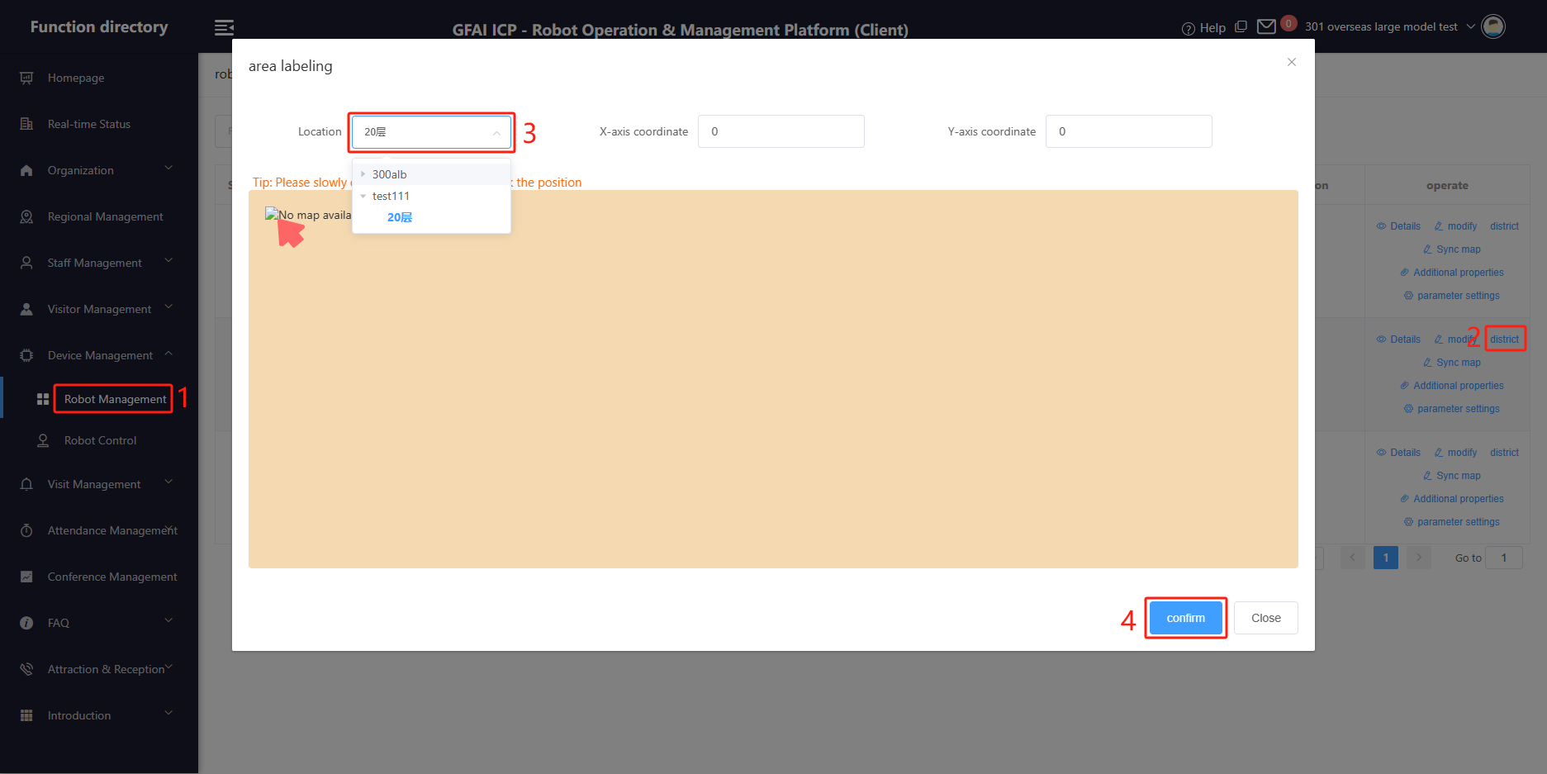
3. Synchronize the robot work map(同步机器人工作地图)
Operation path, As shown in the picture: 1 ==> 2 ==> 3 ==> 4
(操作路径，如图所示：1 ==> 2 ==> 3 ==> 4)
Tip: Before operating, make sure that you have completed the basic work such as mapping and building points on the robot,
and have uploaded the map. Please refer to the next page for the operation of uploading maps by robots.
(操作之前请确保在机器人上已完成建图建点等基础工作,并已上传地图。机器人上传地图操作请见下页)
Step 3, when there are multiple maps, select the map that the robot needs to use.
(第3步，当有多张地图时，请选择机器人需要使用的地图)

Slide 8
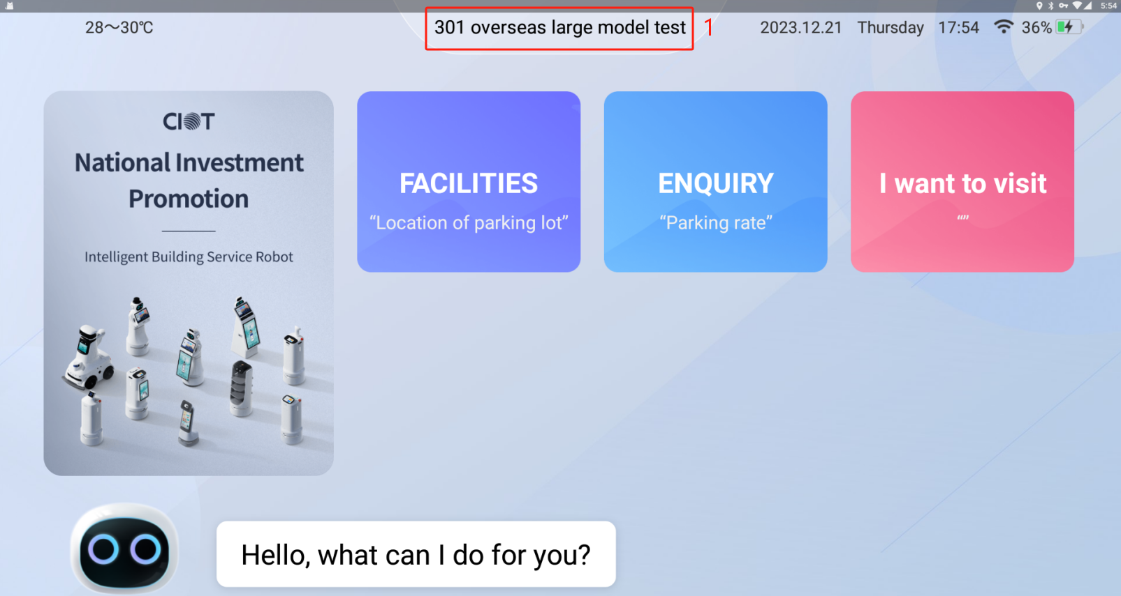
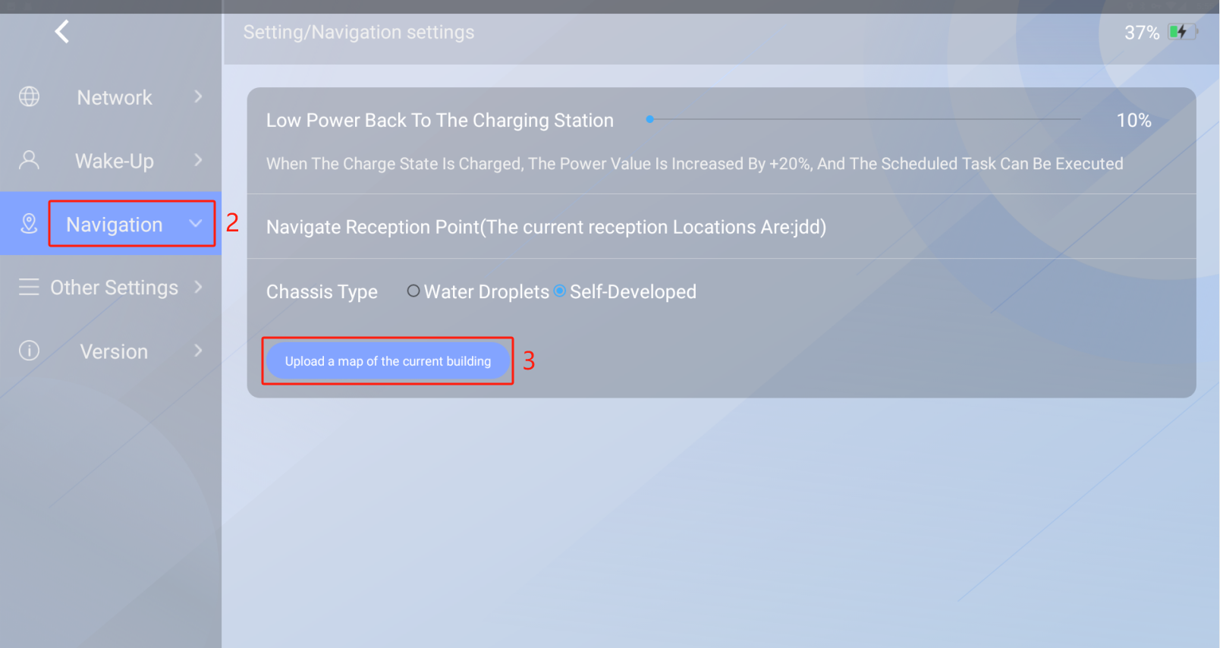
4. Robot uploads the map(机器人上传地图)
Operation path, As shown in the picture: 1 ==> 2 ==> 3
(操作路径，如图所示：1 ==> 2 ==> 3)
Step 1, Click here more than 10 times in a row to enter
the robot settings interface.
(当有多张地图时，请选择机器人需要使用的地图)
Step 3, There will be a pop-up prompt after the map is
successfully uploaded, please pay attention to
view. (地图上传成功后会有弹窗提示，请注意查看)

Slide 9
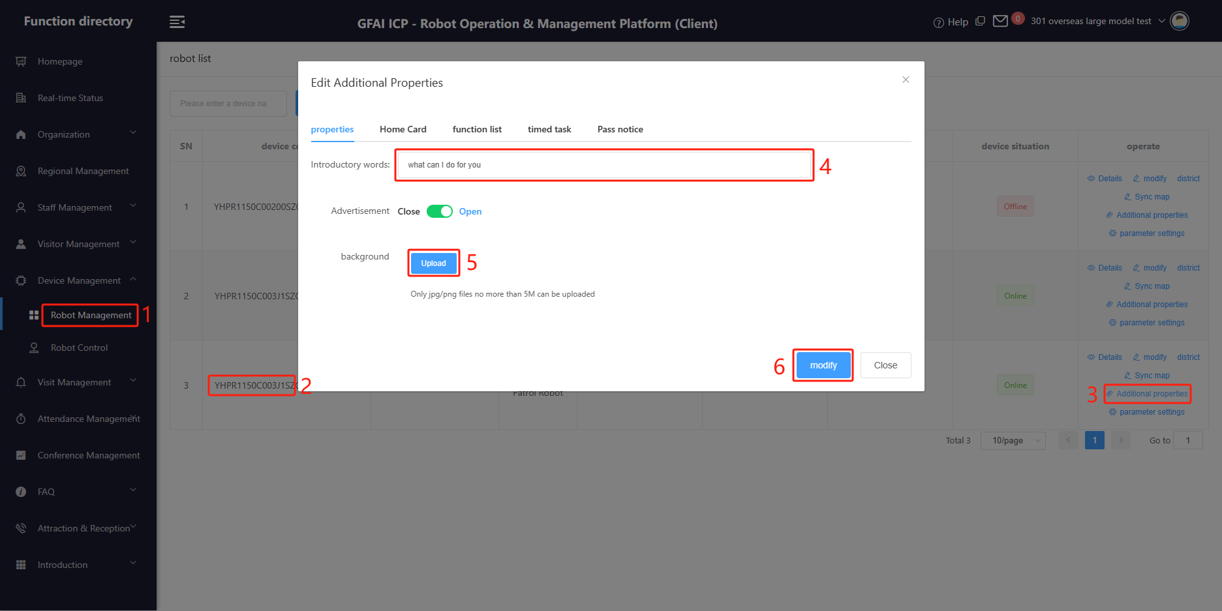
5. Robot welcome message settings(机器人欢迎语设置)
Operation path, As shown in the picture: 1 ==> 2 ==> 3 ==> 4 ==> 5 ==> 6
(操作路径如图所示：1 ==> 2 ==> 3 ==> 4 ==> 5 ==> 6 )
Step 2: Select the robot that needs to be set up according to the device number(第2步：根据设备号选择需要设置的机器人)
Step 4: Set up a welcome message on the robot's homepage(第4步：设置机器人首页的欢迎语)
Step 5: Set the background image for the robot's homepage(第5步：设置机器人首页的背景图片)

Slide 10
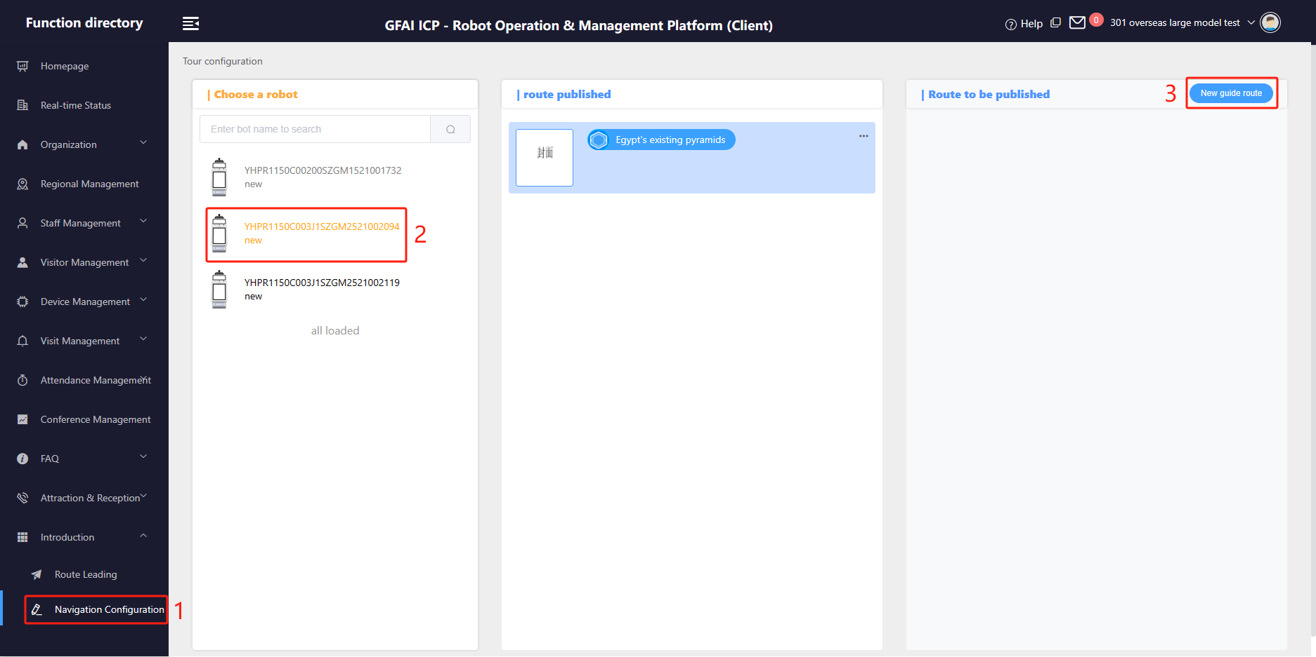
6. GUIDED function setting(迎宾导览功能设置）
This feature is used to guide and explain to guests(此功能用于引导客人参观并为客人讲解)
Operation path,As shown in the picture: 1 ==> 2 ==> 3 ==> 4 ==> 5 ==> 6
(操作路径如图所示：1 ==> 2 ==> 3 ==> 4 ==> 5 ==> 6 )
Step 2, When there are more than one robot, select the target robot(第2步，当有多台机器人时，请选择目标机器人)
Step 3: Create a new guided route(第3步，新建导览路线)

Slide 11
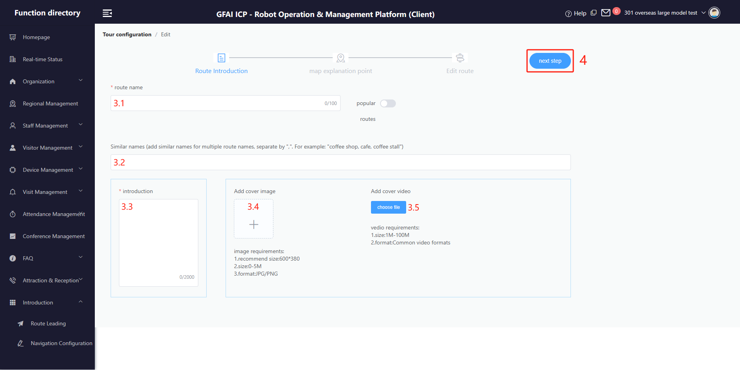
6. GUIDED function setting(迎宾导览功能设置）
Operation path,As shown in the picture: 1 ==> 2 ==> 3 ==> 4 ==> 5 ==> 6
(操作路径如图所示：1 ==> 2 ==> 3 ==> 4 ==> 5 ==> 6 )
3.1 and 3.2: Route name and route similar name (used to trigger this guided route by voice)
路线名称和路线相似名称（用于语音触发该引导路线）
3.3: Route introduction, this content is displayed in the robot body(路线简介，此内容在机器人本体显示)
3.4 and 3.5: Pictures and videos of the route will be displayed on the main body(路线的图片和视频，会在本体显示)

Slide 12
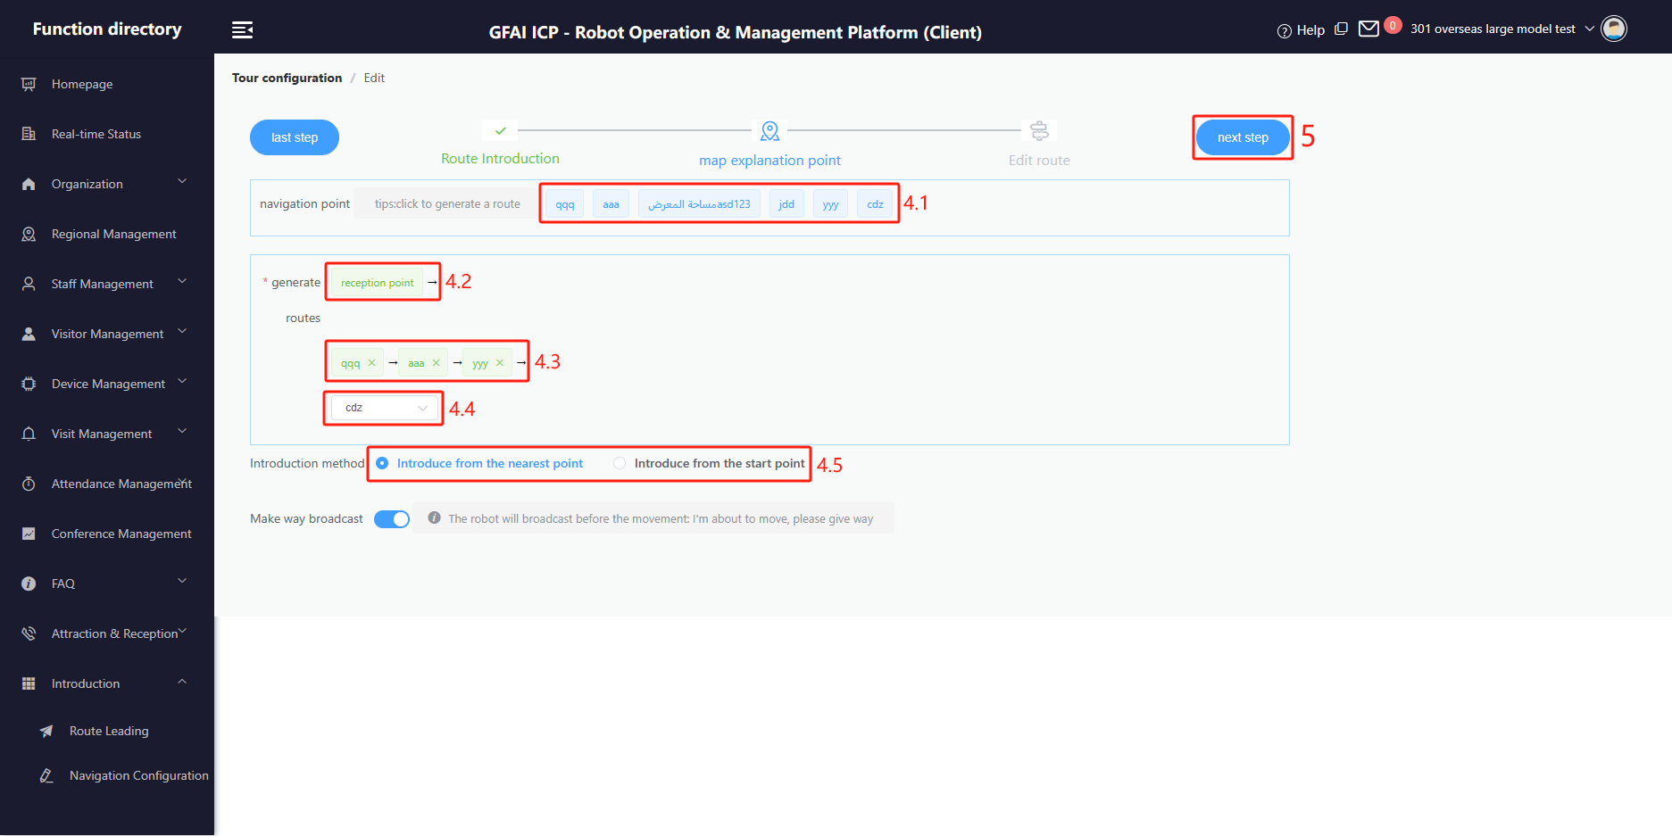
6. GUIDED function setting(迎宾导览功能设置）
Operation path,As shown in the picture: 1 ==> 2 ==> 3 ==> 4 ==> 5 ==> 6
(操作路径如图所示：1 ==> 2 ==> 3 ==> 4 ==> 5 ==> 6 )
4.1 All navigation points created when creating a new map (you can click here to select the route points of the route).
新建地图时创建的所有导航点位（可以点选此处选择线路的途径点位）
4.2 The starting point of the route, which cannot be modified(路线的起点，不可修改)
4.3 The route point of the route can be modified by clicking on it(路线的途径点，可以点击修改)
4.4 The end of the route(路线的终点)
4.5 Set the starting point for the robot to start the explanation(设置机器人开始讲解的起始点)

Slide 13
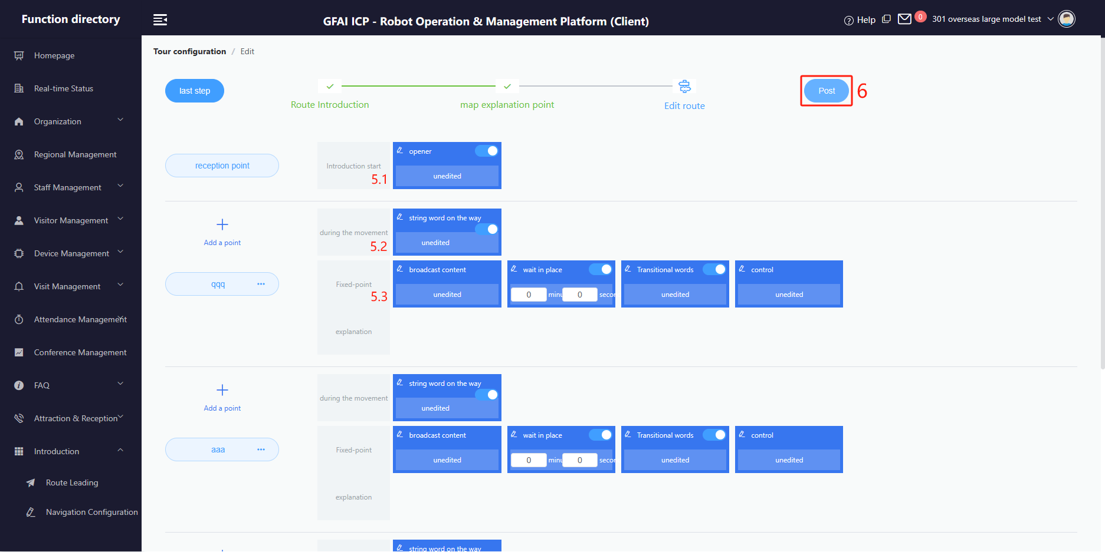
6. GUIDED function setting(迎宾导览功能设置）
Operation path,As shown in the picture: 1 ==> 2 ==> 3 ==> 4 ==> 5 ==> 6
(操作路径如图所示：1 ==> 2 ==> 3 ==> 4 ==> 5 ==> 6 )
5.1 Set the content of the voice broadcast before departure(设置准备出发时的语音播报内容)
5.2 Set the voice broadcast content during the journey(设置行驶途中的语音播报内容)
5.3 Set the content of the voice broadcast at the arrival point and the setting of the waiting time
(设置到达途径点的语音播报内容，以及等待时间和语音控制指令)
Note: The above can be set separately for each route point(每个途径点位都可以单独设置以上内容)

Slide 14
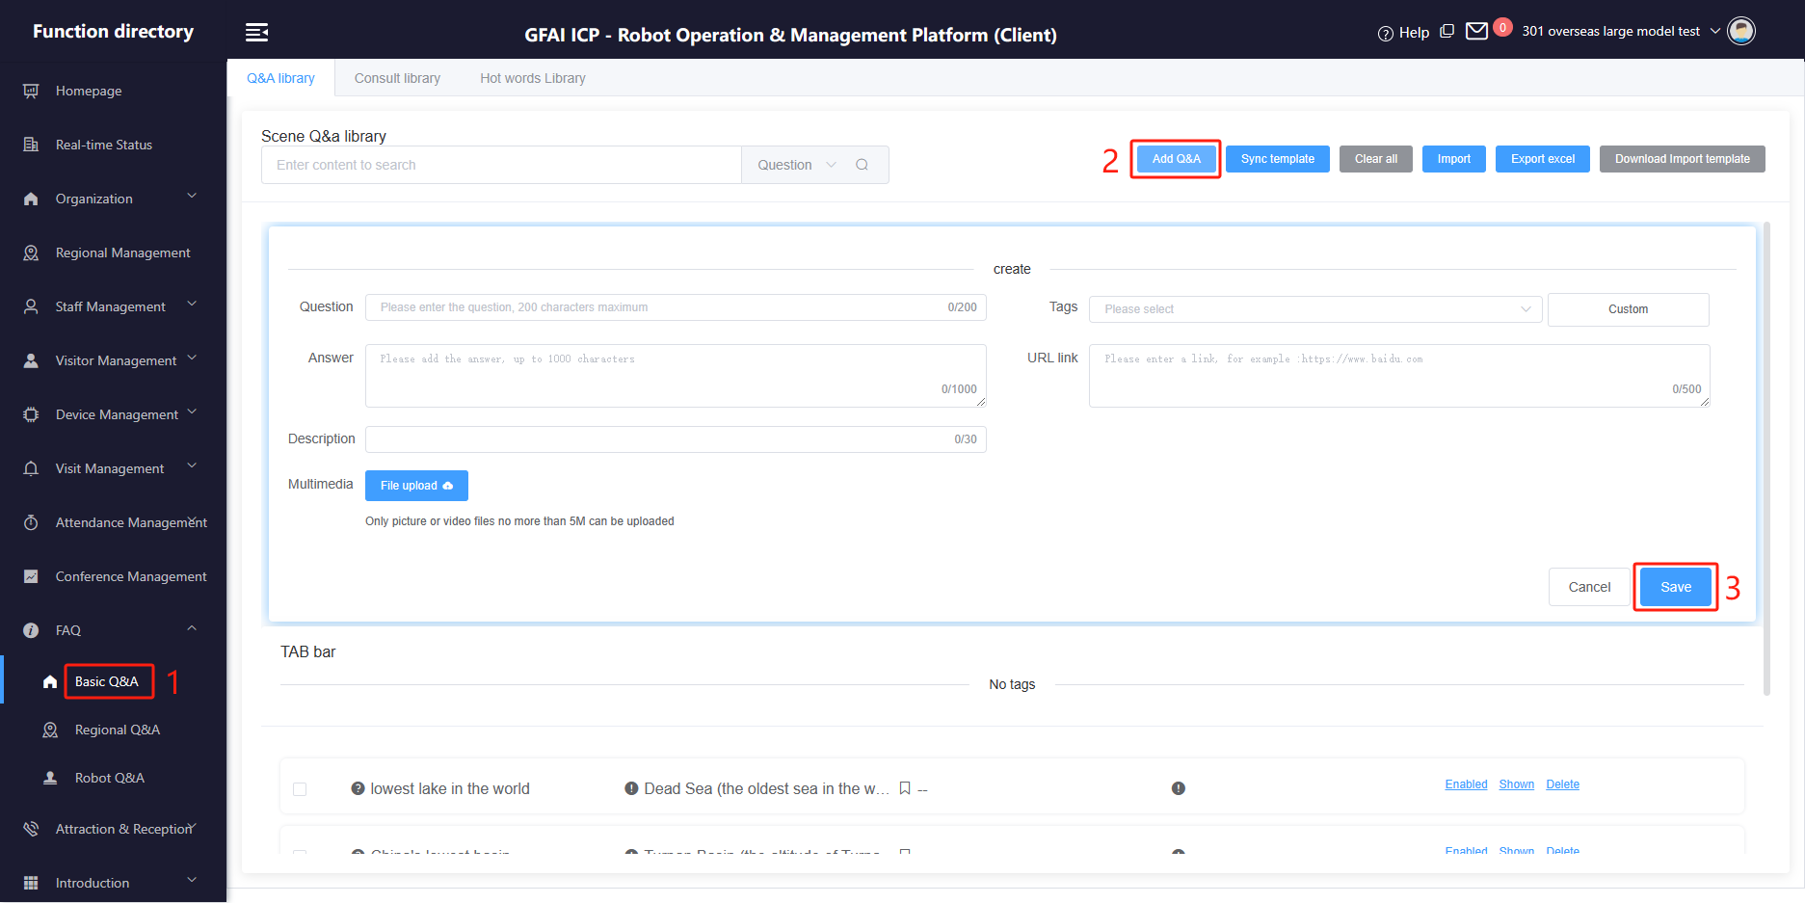
7. ENQUIRY Q&A settings(咨询服务问答设置)
For voice conversations between robots and guests(用于机器人和客人之间的语音对话)
Operation path: As shown in the picture: 1 ==> 2 ==> 3 (操作路径,如图：1 ==> 2 ==> 3)
To improve the success rate of Q&A, you can set up multiple similar questions to point to the same answer.
(为了提高问答的成功率，您可以设置多个相似的问题来指向相同的答案)
Q&A content are divided into three categories(问答内容分为三类):
a) Basic Q&A(基础问答):
For all robots.
(适用于所有机器人)
b) Regional Q&A(区域问答):
Robots for the same workplace.
(同一工作场所的机器人)
c) Robot Q&A(机器人问答):
Specify a single robot.
(指定单台机器人)

Slide 15
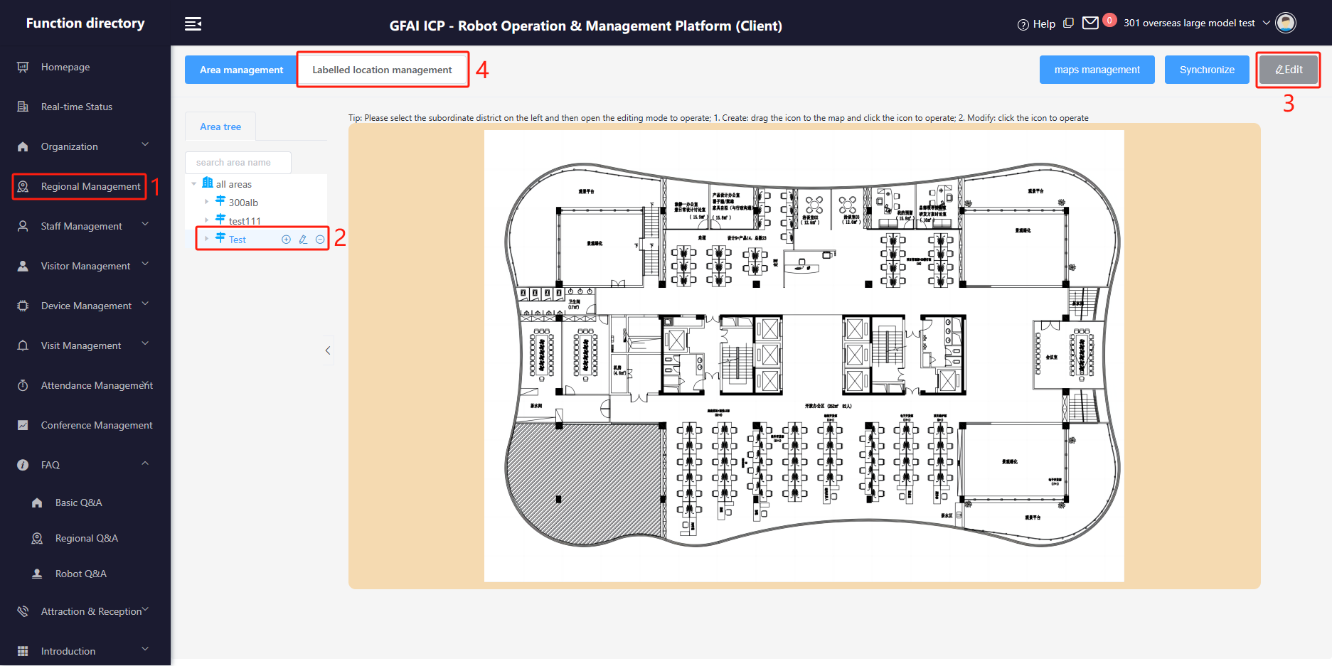
8. FACILITIES function settings(基础设施功能设置)
This feature is used to take guests to their destinations(此功能用于带客人去目的地)
Operation path,As shown in the picture: 1 ==> 2 ==> 3 ==> 4 ==> 5 ==> 6
(操作路径如图所示：1 ==> 2 ==> 3 ==> 4 ==> 5 ==> 6 )
Step 2，You can create and modify workspaces here. When modifying a region, we recommend that you upload a region
plan that is less than 500 KB (optional)
可以在此新增和修改工作区域。修改区域时建议上传一张小于500KB的区域平面图(非必需)

Slide 16
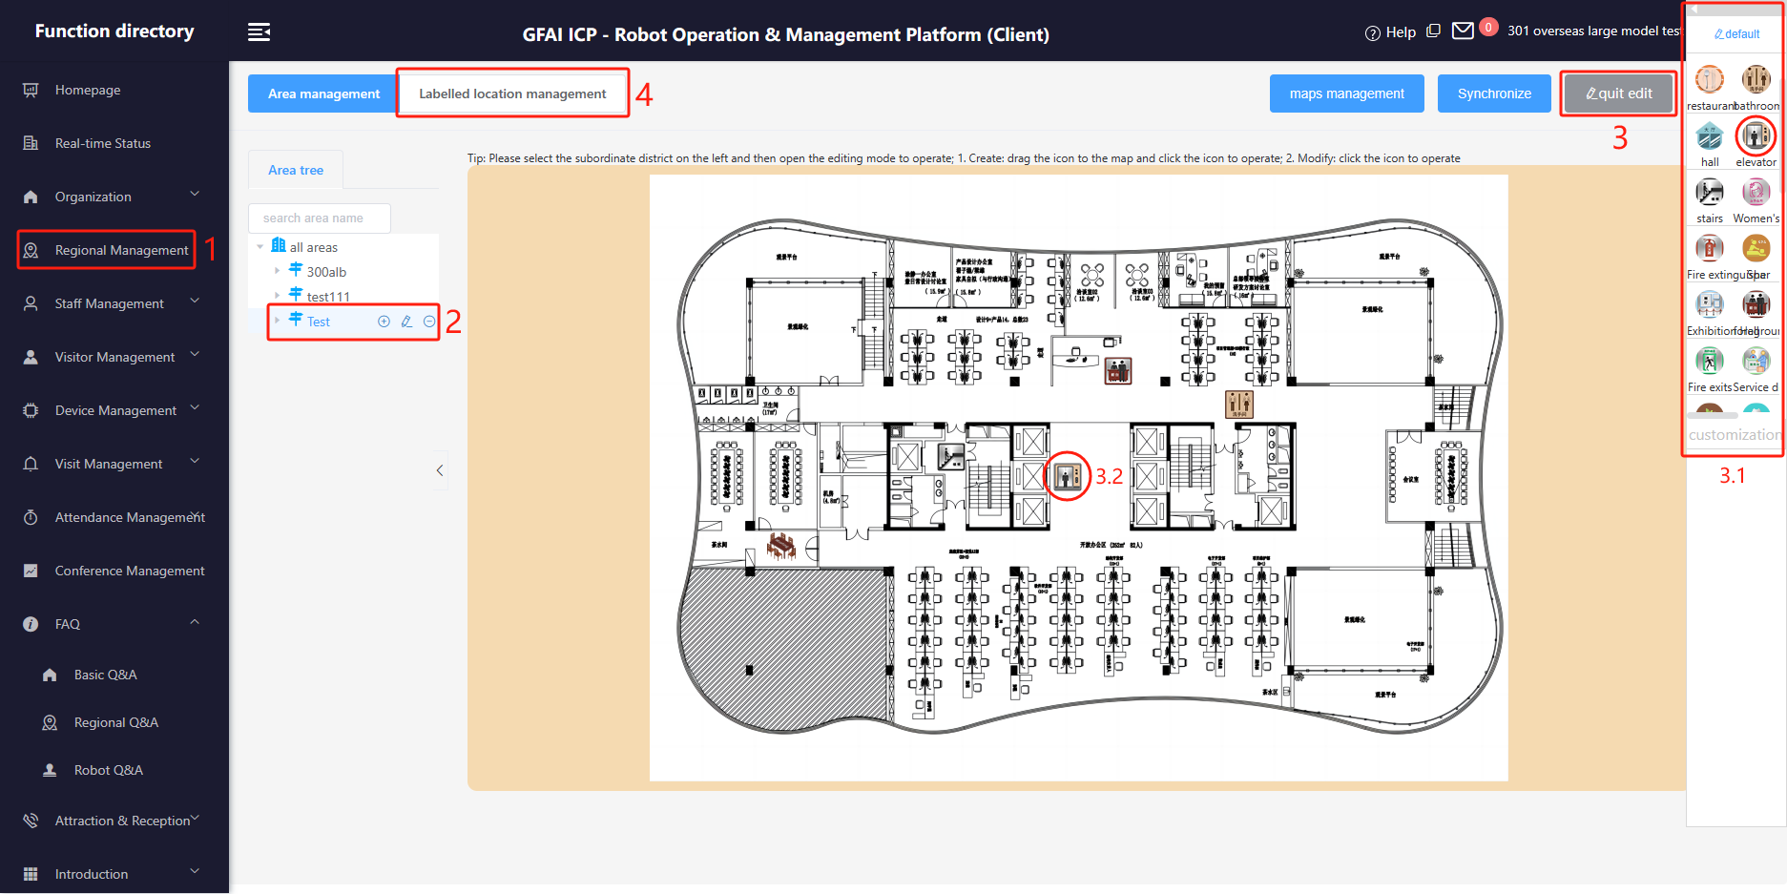
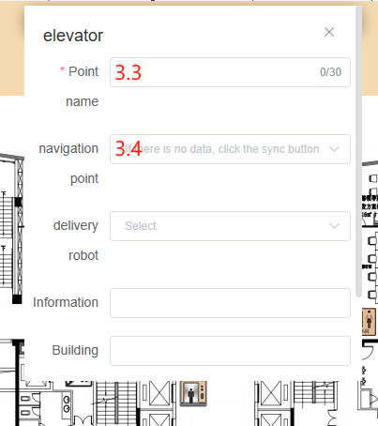
8. FACILITIES function settings(基础设施功能设置)
Operation path,As shown in the picture: 1 ==> 2 ==> 3 ==> 4 ==> 5 ==> 6
(操作路径如图所示：1 ==> 2 ==> 3 ==> 4 ==> 5 ==> 6 )
Drag the icon from the pop-up bar (3.1) on the right to any position on the image (for example, 3.2)
从右侧弹窗栏(3.1)中用鼠标拖动图标到图片上任意位置(例如3.2)
3.2 Click on the icon (e.g. 3.2) to edit the point（点击图标（如3.2）进行点位编辑）
3.3 Give the point a name. Be careful to keep the name short and precise, as this name will be used as a voice keyword to trigger the
lead function.(给点位命名。注意名字要简短且精准，因为此名字将做为触发引导功能的语音关键词)
3.4 Associating a robot
navigation point with
a point.(为点位关联机器
人导航点)

Slide 17
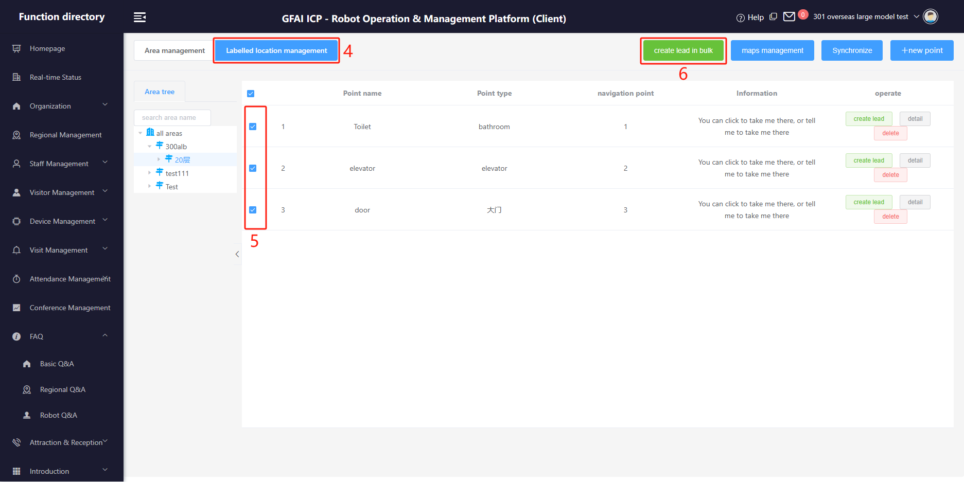
8. FACILITIES function settings(基础设施功能设置)
Operation path,As shown in the picture: 1 ==> 2 ==> 3 ==> 4 ==> 5 ==> 6
(操作路径如图所示：1 ==> 2 ==> 3 ==> 4 ==> 5 ==> 6 )
Step 5，Select the points as needed(根据需要勾选点位)
Step 6，Publish the bootstrap feature. After success, there will be a pop-up prompt.(发布引导功能。成功后会有弹窗提示)

Slide 18
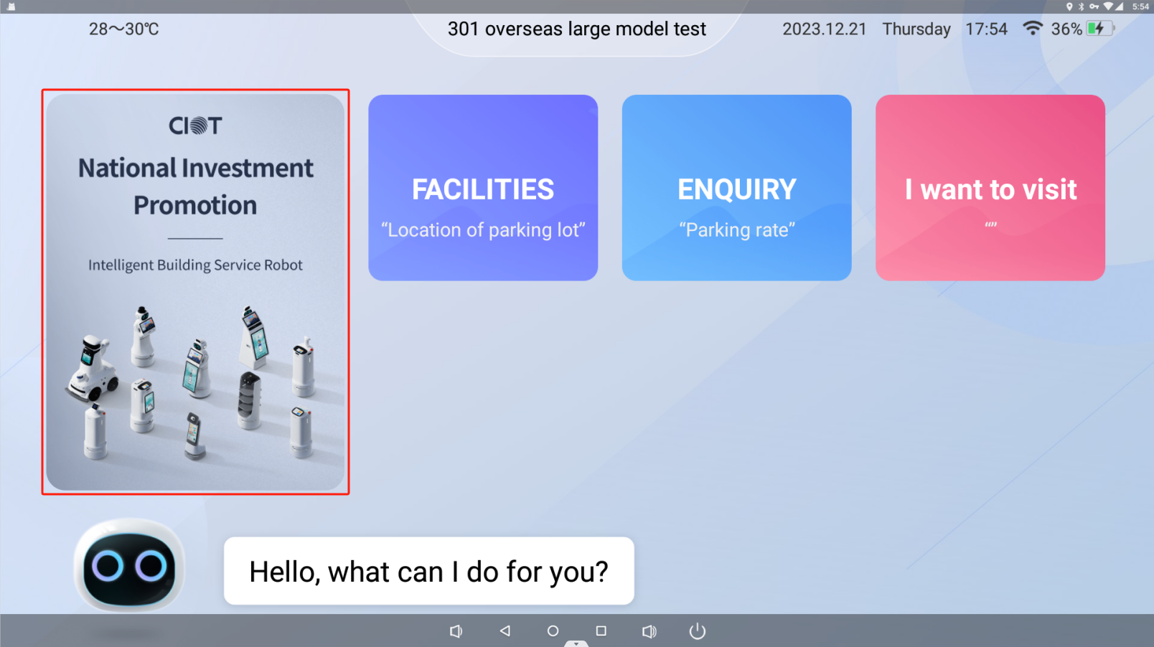
9. How-to guide for advertising launches(广告发布操作指南)
The ad slot on the left can be used to serve image ads or video ads as needed.
左侧广告位可以根据需要投放图片广告或视频广告
For details of the advertising operation, please refer to the document "02 Advertising upload for reception robot".
详细的广告投放操作，请参看文档《02 接待机器人广告发布》

Slide 19


